Slide 1


Presented by: Aulliya Dwi Armita
INCREASING EMPLOYEE CAPABILITIES IN THE HOTEL INDUSTRY: CASE STUDY OF BALANCED SCORECARD IMPLEMENTATION FROM A LEARNING AND GROWTH PERSPECTIVE
Jiwangga Hadi Nata, Cindi Laurencia Soebagio, Umi Farichah Bascha, Dian Yulie Reindrawati, Aulliya Dwi Armita
Notes:
Hi everyone,
My name is Aulliya, and I'm here to talk to you about our research on increasing employee capabilities in the hotel industry.
I'm really passionate about this topic, and I hope you'll find it as interesting as I do.
I'm joined by my co-authors, Mr Jiwangga, Ms Cindi, Mrs Umi, and Mrs Dian.
We've been working on this research for a few month, and we're excited to finally share it with you.

Slide 2


TABLE OF CONTENTS
Introduction
Overview of Balanced Scorecard
Research Method
Case Study: Balanced Scorecard Implementation
Employee Capability Enhancement Strategies
Benefits and Outcomes
Interview Result
Conclusions
Notes:
The following are the details of the discussion that we will convey today. So I will convey the points listed below. To shorten the time, I'll just start straight away

Slide 3


Background of The Hotel Industry
The Westin Surabaya Hotel has measured the success of its performance using the Balance Scorecard, which of course has paid attention to the balance point or not only from a financial perspective.
INTRODUCTION
Importance of Employee Capabilities
Increasing employee capabilities can increase operational efficiency and provide quality service to guests.
Skilled employees can overcome dynamic industry challenges and make positive contributions to the customer experience.
In the context of Balanced Scorecard implementation, a focus on employee growth and learning helps create an innovative and adaptive environment.

Slide 4

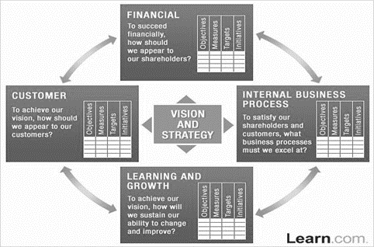
Overview of Balanced Score
Financial perspective
Customer perspective
Internal business process perspective
Learning and growth perspective
Notes:
BSC (Balance Scorecard) is a method of measuring or assessing the level
of company performance achievement which can be reviewed through several
aspects or what is often called perspective.
The perspectives or component aspects in question are financial
perspective, customer perspective, internal business process perspective. , as well
as a learning and growth perspective (Hansen and Mowen, 2009:366 in Surya,
2014).
1. The financial perspective aims to ensure that the company obtains a return
on the investment made or to measure the achievement of financial success.
2. Perspective Customer focuses on the entity of customer satisfaction with the company's products or services which is an indicator of the company's success.
3. The internal business process perspective is to determine how well the
strategy used by the company is formulated, as well as leading to new ways that can
better meet customer needs.
4. The learning and growth perspective focuses more
on a worker or employee in the company, such as the culture that is promoted, the
work environment that has an influence, the knowledge possessed, and the skills of
each individual within it, and there are many steps that can be taken in the learning
method for employees.

Slide 5
Research Method
Qualitative approach.
Descriptive research.
Held January to July 2022.
The subject is the Human Resources Department.
The population was approximately 200 employees.
The method used is purposive sampling
The qualitative International Conference on Economy, Management, and Business (IC-EMBus) 5 data analysis technique used is the Miles, Huberman & Saldana (2014) model,
Notes:
The type of research approach used in this research is a qualitative
approach. The type of approach used in this research is descriptive research. This
research activity starts from January to July 2022. The object of this research is an
effective strategy or optimization strategy for achieving a learning and growth
perspective in the Balance Scorecard through an organizational culture and work
environment approach at The Westin Surabaya Hotel. The subject of this research
is the Human Resources Department. The population in this study was
approximately 200 employees. The method used in determining the sample is
purposive sampling, namely with the requirement that workers or employees have
at least 2 years of experience in the field of Human Resources, with ages 20 to 55
years. The data collection methods used in this research are library research and
field studies consisting of interview methods, observation methods and
documentation methods with attached data for the past two years. The qualitative
International Conference on Economy, Management, and Business (IC-EMBus) 5
data analysis technique used is the Miles, Huberman & Saldana (2014) model,
namely data collection, data reduction, data presentation, and drawing conclusions.

Slide 6
CASE STUDY
Balanced Scorecard Implementation
Example case study
Implementation Process
Solutions
The freedom an employee has to upgrade their knowledge through the training process and support provided by management.
Employee freedom or independence to upgrade skill or knowledge is very independent. It just has to be in accordance with the company's goals or vision. Everything is fully supported by management, as long as it does not neglect the duties and responsibilities that should be carried out.
It is concluded that there is freedom for an employee to explore new knowledge, as well as very good support from management to provide everything that can support the learning program to create employees who have good skills or achieve employee capabilities.

Slide 7
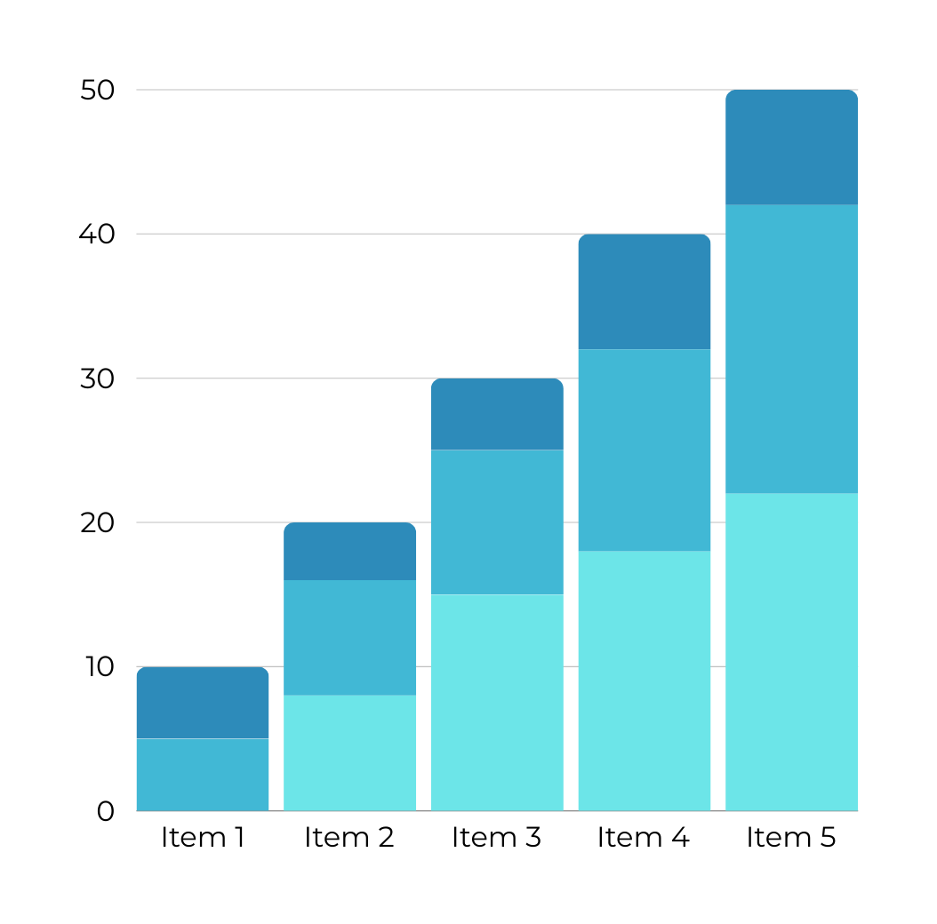

EMPLOYEE CAPABILITY ENHANCEMENT STRATEGIES
Training and Development Programs
Leadership and Mentorship Initiatives
Employee Feedback and Continuous Improvement

Slide 8

Benefit and Ootcomes
For Hotel
Hotel ratings getting better
More repeat guests coming
Increasing profits earned
For Employee
Making it easier for employees to do their work in the future
Promotion to a higher position if the employee is deemed capable
Notes:
To achieve a goal, of course the role of existing human resources is very
necessary. According to Robbins, Stephen P. Judge and Timothy A (2008:56),
12 IC-EMBUS VOL.1, 2023
capability can be defined as an ability possessed by a person. However,
capability is not limited to the skills or skills possessed by a person, but rather
how that person also understands in detail and truly masters his abilities starting
from weak points to how to overcome them. This property aims to maintain and
develop employee capabilities optimally so that they can excel and contribute
more to the property. The success or benefits obtained by the property include:
hotel ratings getting better or higher, more repeat guests coming, increasing
profits earned, and of course making it easier for employees to do their work in
the future. Meanwhile, the benefit that employees can experience is promotion to
a higher position if the employee is deemed capable and suitable for that position.

Slide 9
Interview Result
The resource persons who were successfully interviewed intensively were Setyo Budi as Director of Learning and Development, Vanda Setiangga as Complex Human Resources Manager, and Natasha Angelia as Complex Human Resources Coordinator (informant three).
The existence of complex management does not have a big impact on operations, because complex management still refers to the rules and identity of each property
The existing communication pattern takes into account all existing levels of urgency. When there is nothing that can be said to be important or urgent, then all communication patterns are carried out in the same direction according to hierarchical levels
There is freedom for an employee to explore new knowledge, as well as excellent support from management to provide everything that can support the learning program to create employees who have good skills or achieve employee capabilities
The facilities and work environment at The Westin Surabaya hotel are very good and fully meet all needs. The relationship between the employees there is also very good.

Slide 10
Interview Result
There are elements of management, namely P-O-A-C or Planning, Organizing, Actuating, and Controlling. By choosing a strategy in the form of daily training, it will quickly help improve an employee's capabilities
Good achievements in the learning and growth perspective in BSC it will produce very positive things and achieve the hotel's vision and mission very easily

Slide 11

CONCLUSION
An effort to achieve the goals of an organization, of course there are many factors that can influence it.
Organizational culture
Work environment
An effective strategy that can be implemented to achieve a learning and growth perspective in a balanced scorecard is through training programs
Notes:
To achieve an organization's goals, there are undoubtedly numerous factors that can influence its success. Organizational culture and work environment are two crucial factors that play a significant role in goal attainment. One effective strategy that can be implemented to achieve the learning and growth perspective in a balanced scorecard is through training programs.
Effective training programs can enhance employee knowledge, skills, and behaviors, ultimately leading to improved overall organizational performance. Therefore, it is essential for organizations to invest time and resources in developing high-quality training programs.

Slide 12

THANK YOU
Any Questions?
Notes:
Thank you for your attention. We hope this presentation has provided valuable insights into strategies for achieving the learning and growth perspective in a balanced scorecard.
We encourage organizations to consider implementing effective training programs as part of their strategy for achieving their goals.
Thank you and good evening

